Slide 1
Sales Insights A Visual Report

Slide 2
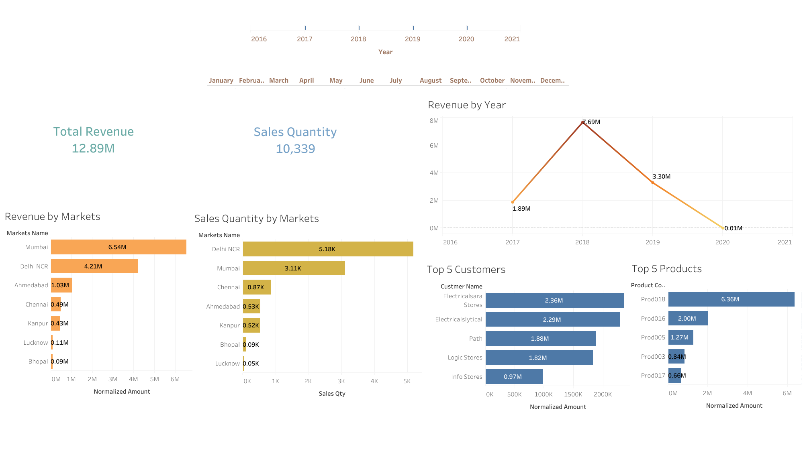

Slide 3
